Slide 1
Web Application Development II
Week 1: Introduction

Slide 2

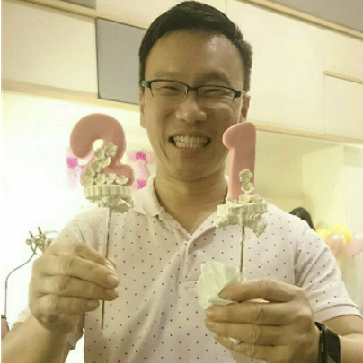
Faculty
SHAR Lwin Khin
Office: SCIS II Level 4, Room 4057
tele: @lkshar
Email: lkshar@smu.edu.sg
MOK Heng Ngee
Office: SCIS I Level 5, Room 5036
tele: @Mokkie
Email: hnmok@smu.edu.sg

Slide 3
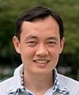
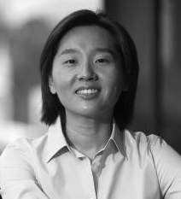
Faculty
Keith FWA Hua Leong
Office: SCIS II Level 4, Room 4055
Email: hlfwa@smu.edu.sg
Kyong Jin SHIM
Office: SCIS I Level 5, Room 5020
Email: kjshim@smu.edu.sg

Slide 4

Faculty
Jason CHUI
Office: SCIS I, Level 2, Instructors Office
Email: jasonchui@smu.edu.sg

Slide 5

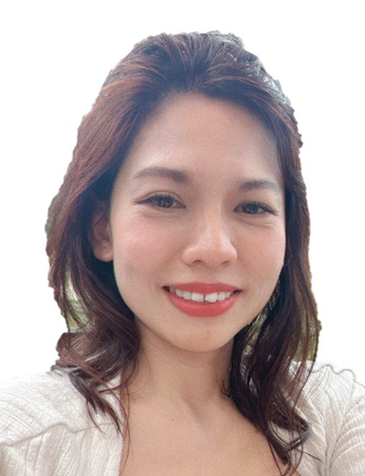
Instructors
THIANG Lay Foo
Office: SCIS I, Level 2, Instructors Office
Phone: 6828 0266
Email: lfthiang@smu.edu.sg
Cordelia LEE
Office: SCIS I, Level 2, Instructors Office
Email: cordelialee@smu.edu.sg

Slide 6
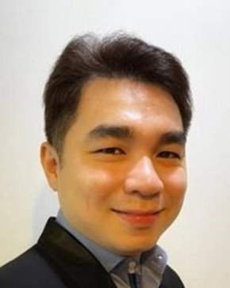
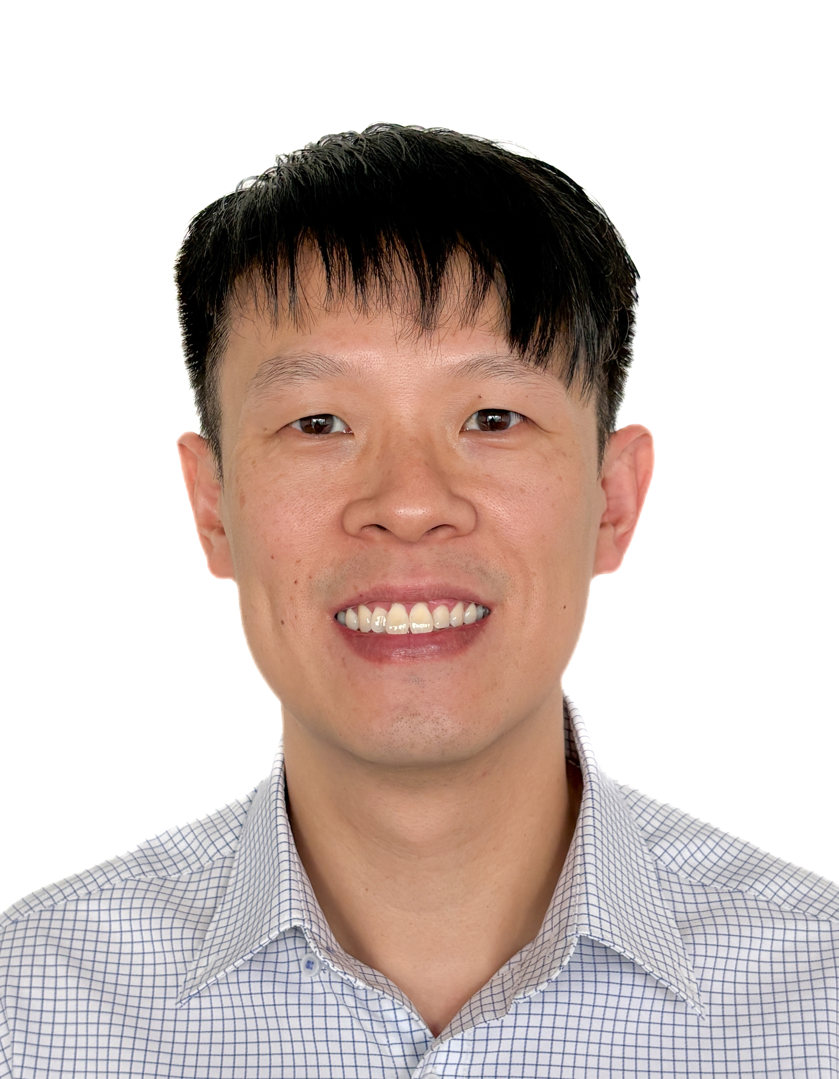
Instructors
WONG Chee Chein
Office: SCIS I, Level 2, Instructors Office
Phone: 6828 0569
Email: ccwong@smu.edu.sg
Alvin TAY
Office: SCIS I, Level 2, Instructors Office
Phone: 6808 7964
Email: alvintaylz@smu.edu.sg

Slide 7
Teaching Schedule
Section | Day | Time |  | Venue | Faculty | Instructor
G1 | Mon | 12:00 | 15:45 | SOE/SCIS2 SR 3-4 | Shar Lwin Khin | Thiang Lay Foo
G2 | Mon | 19:00 | 22:15 | SCIS1 SR 3-3 | Shar Lwin Khin | Thiang Lay Foo
G3 | Thu | 12:00 | 15:15 | SOE/SCIS2 Computing Lab B1-1 | Kyong Jin Shim | Wong Chee Chein
G4 | Thu | 15:30 | 18:45 | SOE/SCIS2 Computing Lab B1-1 | Kyong Jin Shim | Wong Chee Chein
G5 | Tue | 15:30 | 18:45 | SCIS1 SR 2-3 | Mok Heng Ngee | Wong Chee Chein
G6 | Wed | 08:15 | 11:30 | SCIS1 SR 3-1 | Mok Heng Ngee | Cordelia Lee
G7 | Wed | 12:00 | 15:15 | SCIS1 SR 3-1 | Mok Heng Ngee | Wong Chee Chein
G8 | Tue | 08:15 | 11:30 | SCIS1 SR 2-3 | Fwa Hua Leong | Alvin Tay
G9 | Tue | 12:00 | 15:15 | SCIS1 SR 2-3 | Fwa Hua Leong | Alvin Tay
G10 | Wed | 08:15 | 11:30 | SCIS1 SR 2-2 | Fwa Hua Leong | Alvin Tay
G11 | Mon | 08:15 | 11:30 | SCIS1 SR 2-3 | Jason Chui | Jereme TAN Jing Min (TA) Nicholas LO Eng Hoe (TA)

Slide 8
Sections and TAs
Section | Teaching Assistant
G1 | Don ANG Rui Ze (don.ang.2024@computing.smu.edu.sg)
G2 | Shirin RUTH (shirin.ruth.2024@computing.smu.edu.sg)
G3 | Cham Shin Ron (sr.cham.2024@computing.smu.edu.sg)
G4 | Jia Le Lee (jiale.lee.2024@computing.smu.edu.sg)
G5 | Dwayne Arnold Aniban Otero (daa.otero.2024@computing.smu.edu.sg) @dwaytero
G6 | Chong Yu Hui (yuhui.chong.2024@computing.smu.edu.sg) @chilibanmian
G7 | Brian Leong Jie Ren (brian.leong.2024@computing.smu.edu.sg) @bljrrr
G8 | Swen Teo (swen.teo.2024@computing.smu.edu.sg)
G9 | Ryan Ngui (ryan.ngui.2024@computing.smu.edu.sg)
G10 | Bryan Yap (bryan.yap.2024@computing.smu.edu.sg)
G11 | Jereme TAN Jing Min (jereme.tan.2024@computing.smu.edu.sg) Nicholas LO Eng Hoe (nicholas.lo.2024@computing.smu.edu.sg)

Slide 9
Overview
Computational Thinking & Programming
Basic Programming & Logics
Web Application Development
Web Programming & Problem Solving
(backend + simple frontend)
Web Application Development II
Web Programming & Problem Solving
(frontend)
Software Project Management or Collaborative Software Development or IT Software Architecture
Managing Software Projects

Slide 10
Course Objectives
Concepts
Styling
Building responsive, interactive Web pages
Client-side programming
Interaction with DOM
Event Handling
Using APIs and frameworks
Problem analysis and solving
Meat
HTML
CSS
JavaScript
DOM
Bootstrap
Vue.js

Slide 11
Learning Outcomes
What are the program learning outcomes?
https://scis.smu.edu.sg/bsc-information-systems/majors/information-systems
Course design document and course learning outcomes
Course Design Document

Slide 12
Course Structure
Week | Topic | Remark
1 | Introduction + HTML/JS Recap + Web Services + Git/GitHub
2 | CSS Part I: Vanilla CSS
3 | CSS Part II: Bootstrap | Project Briefing
4 | Vue I: Building reactive, interactive pages DOM Manipulation | Quiz 1
5 | Vue II: Event Handling, Axios API calls, JSON data handling
6 | Vue III: Modularization with components | Quiz 2
7 | Trial Lab Test | Lab Test (25%) 2 Oct (Friday) 345pm-545pm
8 | Recess week
9 | Project Progress Evaluation (5%) | ad-hoc / online
10 | Unit, Integration, E2E Testing
11 | Vue IV: Routing and State Management | Quiz 3
12 | Project Work Week (Consultation) | Quiz 4 Project Submission: Friday 9am
14 | Final Project Presentation (25%) | In-class presentations No class on Wk13
>= 15 | Final Exam (30% 2hr)

Slide 13
Assessments
Continuous assessment
Lab Test 1 (25%)
Duration: 2 hours
Student to bring own laptop computer for live coding
No monitor, no extra computing devices except one laptop
No Internet
open book, hard copies & offline materials allowed
use of ChatGPT / Co-Pilot / GAI is not allowed
Project (30%)
Progress evaluation in Week 9 (5%)
Final presentation in Week 13 (25%)
Class Participation (15%)
Quizzes
Class/Slack activeness
Exercises
Exam
Final exam – Written Test (30%)
Duration: 2 hours
Student to bring own laptop computer
No monitor, no extra computing devices except one laptop
No Internet
Closed book
Using Lockdown browser

Slide 14
Class Format and Participation
Exercises
In-class exercises will be plenty, we will help debugging and providing hints.
Extra exercises will be provided for each topic for capable students.
Sample solutions will be provided by Fridays.
Attendance
1 mark (of total grade) will be taken off for each absence without valid reason
CP points will be deducted for lateness
How to get 15% Class Participation Marks?
4 Quizzes: must attempt once within the given duration (in eLearn Merged section). Unlimited #attempts. Max pts taken. Strictly no deadline extension!!!
Pop Quizzes: Three CP points for top 5
Coding Tests: CP points
One CP point for showing your completed in-class or extra exercises by the subsequent class, e.g., show your wk1 exercises by wk2 Monday, to TA, Instructor, or Faculty
One CP point for asking/answering good questions.
Two CP points for demonstrating your exercise solution in the class.

Slide 15

Late Submission Policy
1 hour late: 10%
> 1 hour late: 100%

Slide 16
Project (30%)
Group project (6 pax)
Either Section faculty form your group or Form your own group. Please check with your teacher.
Propose your own project (detailed requirements will be announced in Week 3).
Your group is to deliver a 5-minute proposal pitch in Week 9. Instructor will provide feedback.
All project deliverables are due Week12 Friday 9am (no further changes allowed for any reason).
Your group will present your project in Week 13.
Peer evaluation: 5% of your project grade (out of 30%) will be based on the peer evaluation with the faculty's professional judgement.

Slide 17
Team Conflict Management
Teamwork is implicit part of the project contribution
Stage 1 — Team discussion
Students should first make a reasonable attempt to resolve disagreements within the team, such as unequal workload or lack of contribution, missing internal deadlines, poor communication or repeated absence from meetings, disagreement about technical decisions or project scope
Stage 2 — Written warning within team
Give a written warning after internal discussions are not successful.
Keep evidence: signed meeting notes, task allocation records, git commits, written warnings
Stage 3 — Instructor mediation
If the team cannot resolve the problem after discussing it internally, they should contact the instructors. Conflict-repoting deadline: minimum two weeks before the project submission deadline.
Teams should not wait until immediately before or after project submission to report long-standing team problems. Instructors will not intervene if the issues are reported after the conflict-reporting deadline. Mark adjustment, in this case (issues known after the deadline), will be based on peer evaluation and the instructors’ professional judgement.
Stage 4 — Individual contribution review
By default, all the team members get the same grade. But when there is strong evidence of substantially different contribution, individual marks may be adjusted.

Slide 18
Make-Up Policy
Lab Test
If you miss the lab test with an MC or official reason that we deem valid, we may either incorporate your lab test grade into final exam grade (i.e., your final exam grade becomes 55% instead of 30%) or schedule the make-up lab test, subject to the teaching team’s decision
You will get zero for the lab test, if you miss both the lab test and the final exam for any reason.
Final Exam
We will follow university policy
No makeup by default

Slide 19
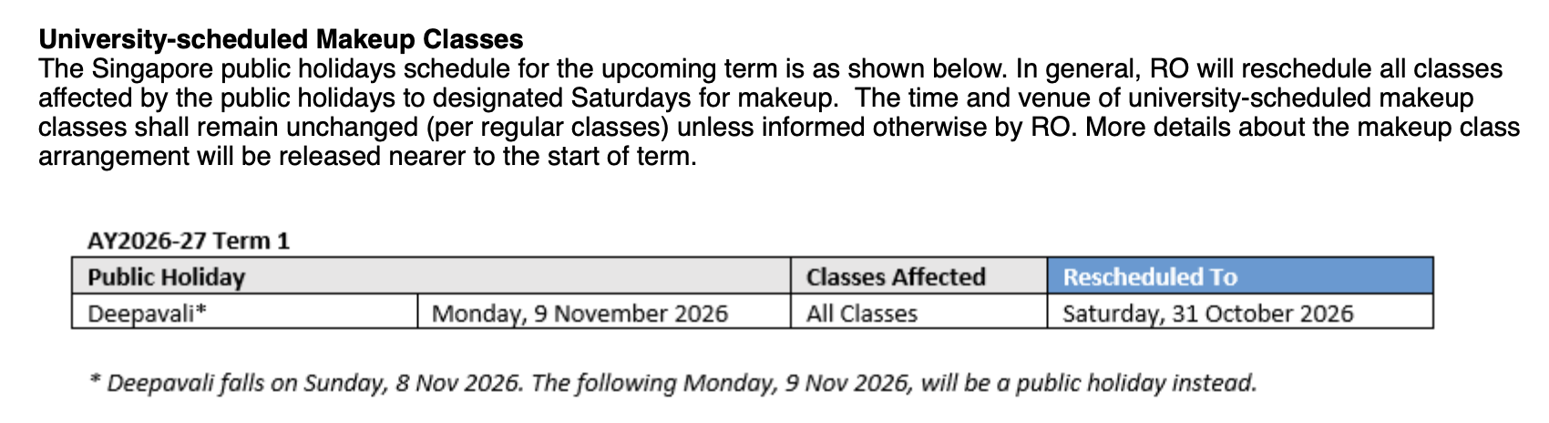
Class Make Up
Affected Week 13 Monday Classes => re-schedule Project Presentations to Week 14 Monday (16 Nov) same time/venue

Slide 20
Incomplete (“I”) Grade
A student must fulfill the following criteria for an “I” grade.
The student is unable to fulfill the course requirement either because of an illness or extenuating circumstances beyond his/her control.
Student must achieve at least 75% attendance in the course.
You are not eligible for ‘I’ grade if you miss the Lab Test even with valid reasons!
Your academic performance must be satisfactory (accumulated score for all attempted components must be at least be 45% of total possible score).

Slide 21
Academic Integrity
All acts of academic dishonesty (including, but not limited to, plagiarism, cheating, fabrication, facilitation of acts of academic dishonesty by others, unauthorized possession of exam questions, or tampering with the academic work of other students) are serious offences.
All work (whether oral or written) submitted for purposes of assessment must be the student’s own work. Penalties for violation of the policy range from zero marks for the component assessment to expulsion, depending on the nature of the offence.
When in doubt, students should consult the instructors of the course.

Slide 22
Plagiarism Management
If you plagiarize, e.g. copy other people’s work for your project or cheat in any test (offline, online), this is the process we follow:
Detection
Investigation
Sanctions
E-learn team or Faculty
Inform Dean’s office (Jeandie LIM)
E-learn team or Faculty
Dean’s office
Office of Dean of Students
Office of Dean of Students
Dean’s office
RO

Slide 23
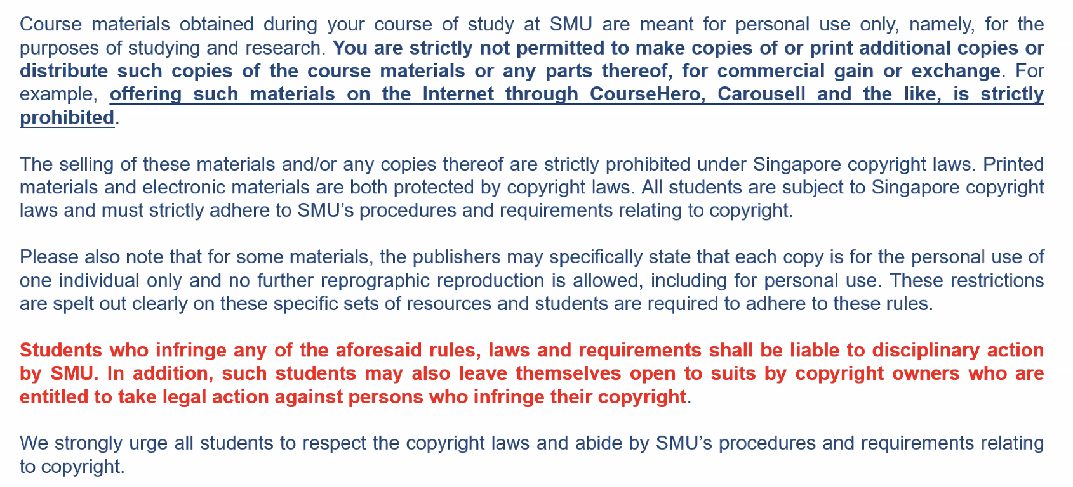
Copyright of Course Materials

Slide 24
References
Learning PHP, MySQL & JavaScript, 7th edition, O’Reilly, Robin Nixon, ISBN13: 978-1098152352
Vue.js 3 in Action, Marcus C. Lauritsen, ISBN13: 979-8291099803
Online resources will be provided for each topic.
Learning by doing.
Notes:
SMU has free O’Reilly resource to these books & more, sign if via your SMU Google’s account to gain access.

Slide 25
Web Application Development II
Week 1: Background

Slide 26
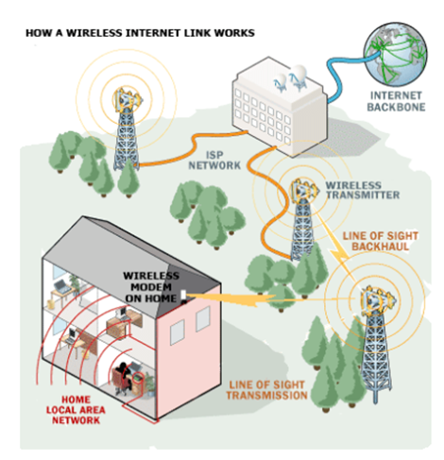
How Web Works
There are many “computers” that hold many files.
The computers are connected through network.
The Web provides a way to access those files on different computers.
Sometimes the files are generated based on the request.

Slide 27
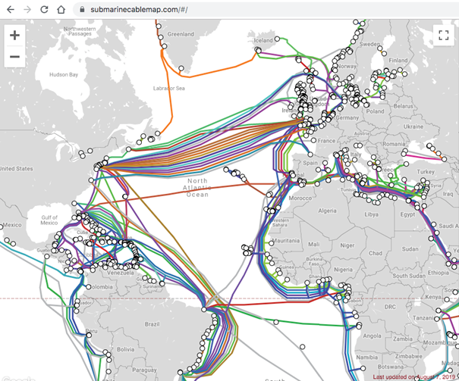
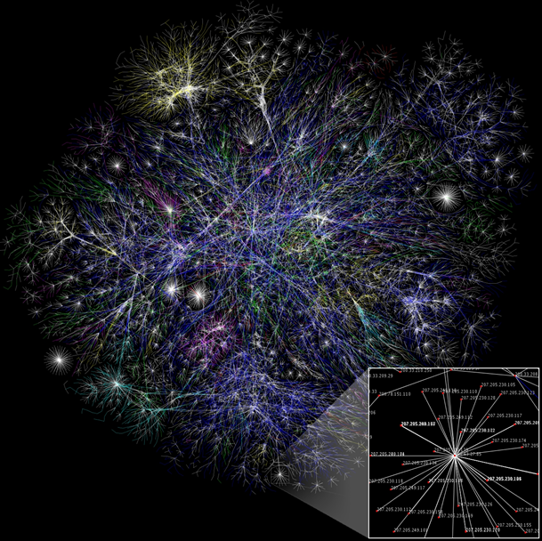
How Web Works
The fibres
The Internet

Slide 28
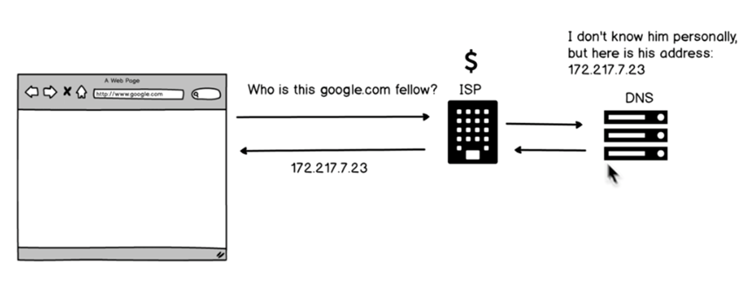
How Web Works

Slide 29
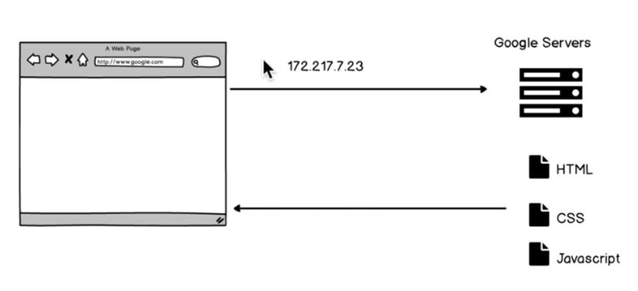
How Web Works

Slide 30
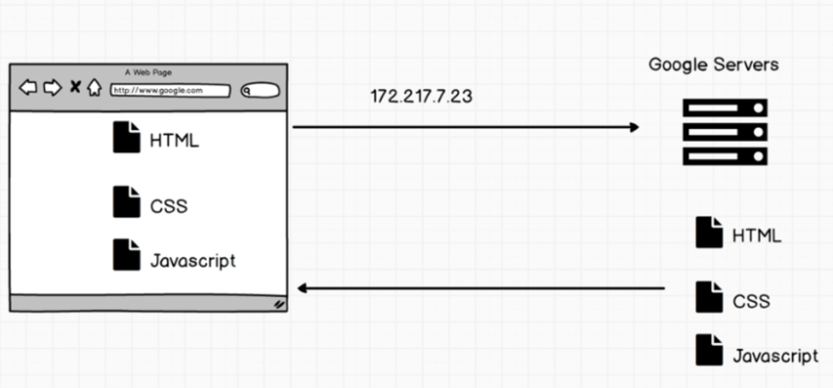
How Web Works

Slide 31
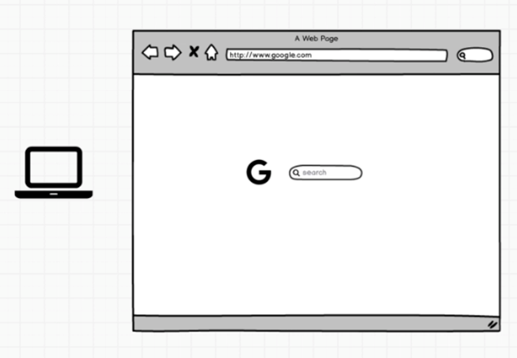
How Web Works

Slide 32
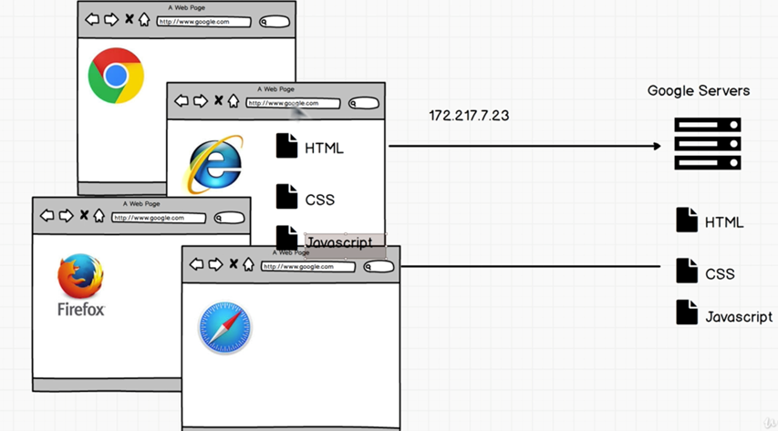
How Web Works: Browsers

Slide 33
How Web Works: Speed
Network speed
Network bandwidth, traffic, location of server, number of trips, size of the files, etc.
Rendering speed
Browser-dependent

Slide 34
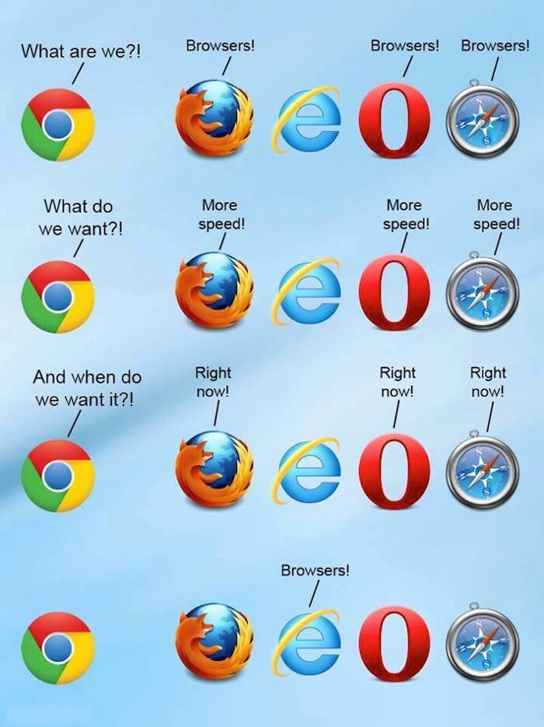
How Web Works: Speed

Slide 35
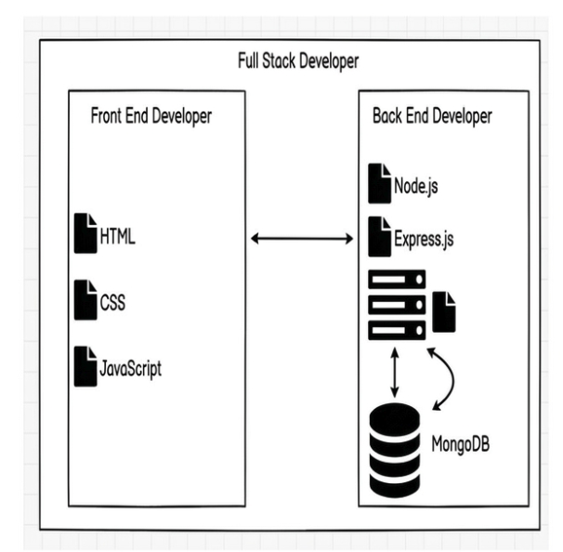
Backend
Node/Express/MongoDB Stack
Node.js: runtime
Express.js: framework
MongoDB: Database

Slide 36
Frontend
HTML: Content
CSS: Presentation
JavaScript: Dynamic effects

Slide 37
Frontend
HTML: Content, nouns
CSS: Presentation, adjectives
Javascript: Dynamic effects, verbs
Example
HTML: <p>a paragraph is here. </p>
CSS: p { color : red; }
Javascript: p.hide()

Slide 38
Tools

Slide 39
Tools
Google Chrome will be the execution environment in this course.
Debug: we will use Chrome DevTools for debugging
Tutorial
In Chrome browser, Right-click and select “View page source” see the page source
Right-click and select “Inspect” to see the DevTools menu.

Slide 40
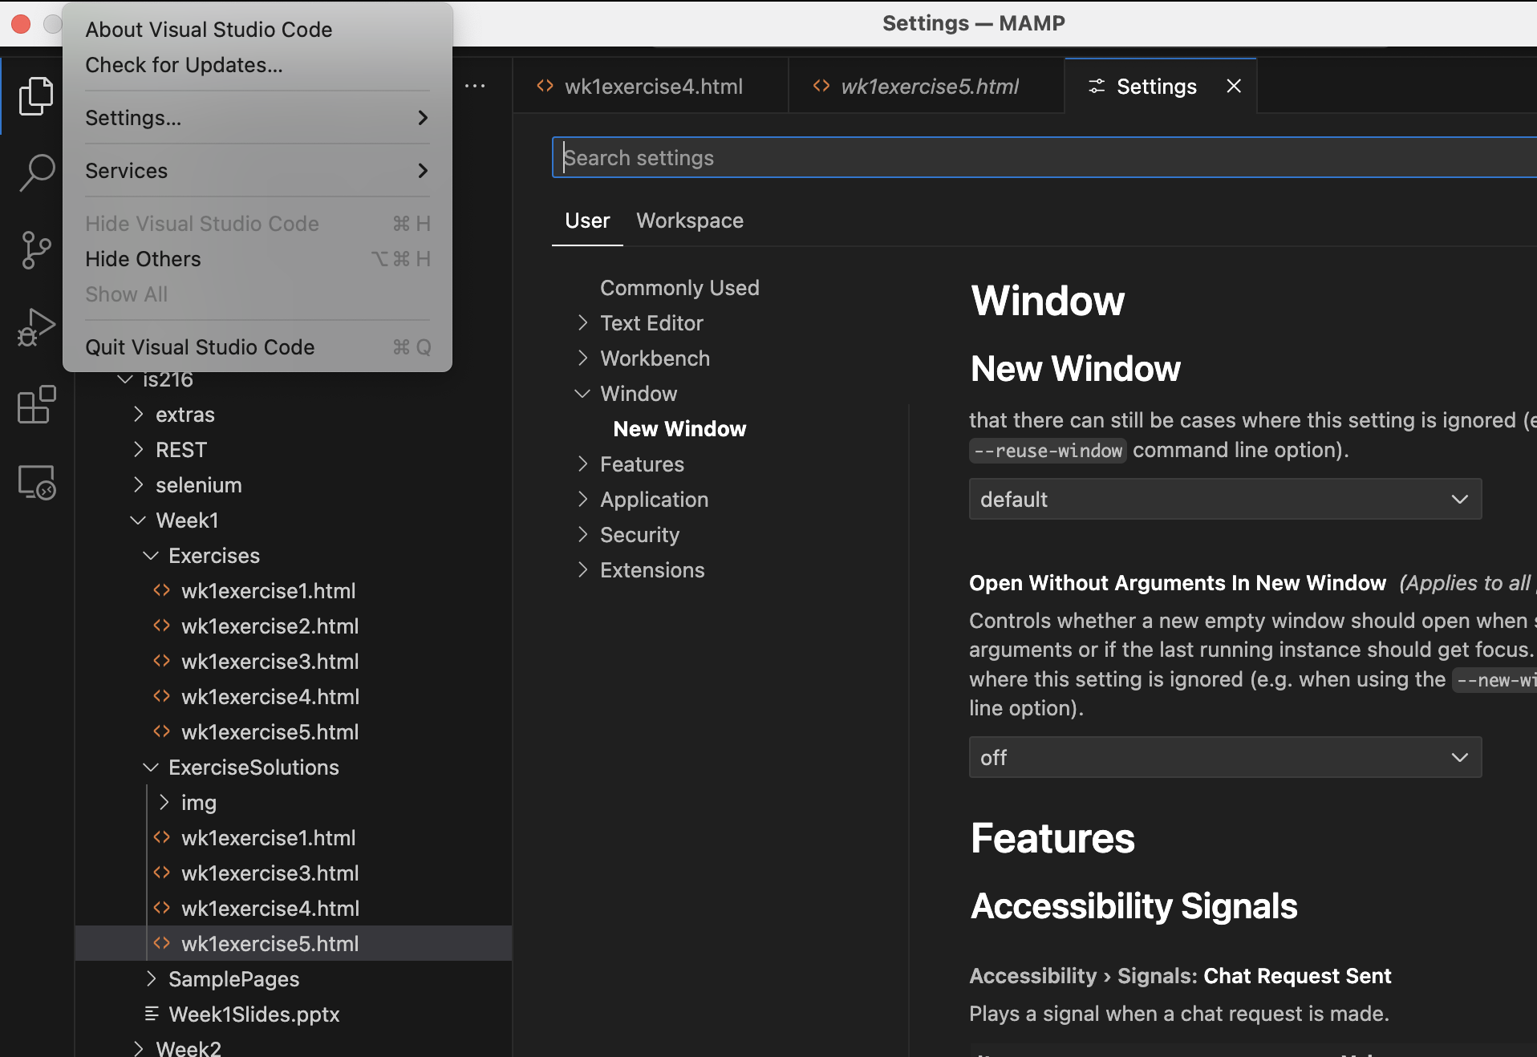
Tools
Visual Studio Code is the editor that we will be using for programming and is recommended to you as well.
VSC
Tip
Make sure auto-save (under File) is checked.
Go to Settings => User and change configurations according to your preferences.

Slide 41
HTML

Slide 42
HTML
HyperText Markup Language
An HTML file contains multiple tags (also known as elements).
There are many kinds of tags.
Tags may have attributes (for specifying their properties); and attributes have values.
HTML Tutorial
Example
<!doctype html>
<html>
<head>
<title>Hello World</title>
</head>
<body>
<p style="text-align:right">
This is a paragraph.
</p>
</body>
</html>

Slide 43
HTML Tags
Tag | Example
Header | <h1>...</h1>, <h2>...</h2>
Paragraph | <p>...</p>
Image | <img src=”...”>
Table | <table><tr><td>...</td></tr></table>
Input field | <input type=”text”>
Button | <button type=”submit”>Submit</button>
Drop down list | <select><option>...</option></select>

Slide 44
Exercise 1
How do we have a dropdown list with an default option?
Given ex1.html, make it so that Sunday is the default option.
Hint: Google - as all programmers do.

Slide 45
HTML Tags
Tag | Example
Ordered list | <ol><li>...<li></ol>
Unordered list | <ul><li>...<li></ul>
Anchor | <a href=’abc.site’>My Homepage</a>
Form | <form action=“newpage.html” method=“GET”>…</form> <form action=“newpage.html” method=“POST”>…</form>
Frame | <iframe width="560px" height="315px" src="https://www.youtube.com/embed/DrDm7uO4Fu0?rel=0"> </iframe>
See examples in wk1example1.html

Slide 46
Styling Related Tags
Tag | Example | Remark
Block | <div id=’div1’>...</div> | Add an ID/class to a block (e.g. for styling)
Inline | <span class=’fav’>...</span> | Like div but smaller
Navigation | <nav>...</nav> | For styling navigation links

Slide 47
Input Fields
Input Type | Description
<input type=“color”> | Input fields that contain a color; a color picker can show up
<input type=“date”> | Input fields that contain a date; a date picker can show up
<input type=“email”> | Input fields that contain an email (check for ‘@’)
<input type=“file”> | File-select field and a “Browse” button for file uploads
<input type=“number”> | Input fields that accept only numeric values
... | ...

Slide 48
Attributes
Attribute | Description
max | Specifies the maximum value for an input field
min | Specifies the minimum value for an input field
maxlength | Specifies the maximum number of characters for an input field
readonly | Specifies that an input field is read only (cannot be edited)
required | Specifies that an input field is required (cannot be empty)
selected | Specifies that a drop-down option is selected by default
checked | Specifies that an item is checked by default
…. | …

Slide 49
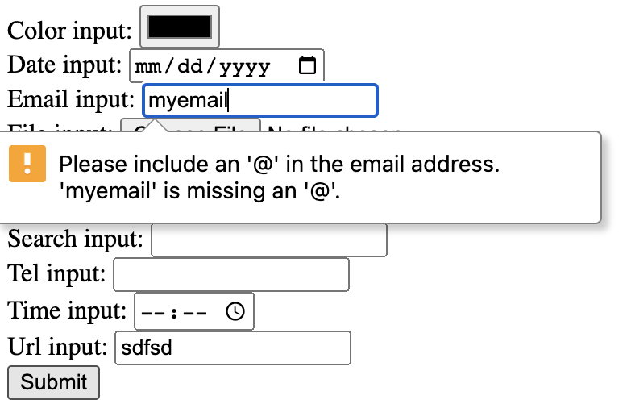
Exercise 2
Play with ex2.html with erroneous inputs.
Consider this question: what if you have more specific requirements on the inputs.

Slide 50
HTML5 Tags
Tag | Description
<header>...</header> | A container for introductory information
<footer>...</footer> | footer information such as copyright or links to related resources
<section>...</section> | contains anything that relates thematically (a thematic grouping of information)
<article>...</article> | a standalone body of work, like an article in a newspaper or a blog. Use this tag around blog posts, news articles, etc.
<aside></aside> | use this tag to indicate secondary information, e.g. a side-box (see wk1example2.html)

Slide 51
Meta Tags
The <meta> tag provides information (metadata) about the HTML document. Metadata will not be displayed on the page, but will be machine parsable.
The metadata can be used by browsers (how to display content or reload page), search engines (keywords), or other web services.
Example
<head>
<meta charset="UTF-8">
<meta name="description" content="Free Web tutorials">
<meta name="keywords" content="HTML,CSS,XML,JavaScript">
<meta name="author" content="John Doe">
/*
viewport here allows the designer to control page dimension and scale.
*/
<meta name="viewport" content="width=device-width,
initial-scale=1.0">
</head>

Slide 52
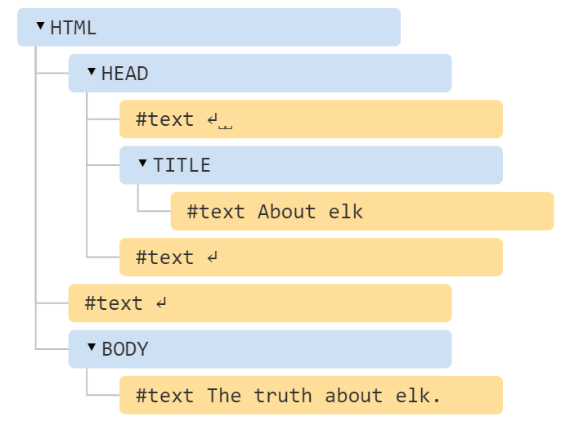
Tree View – Document Object Model (DOM)
An HTML document can be viewed in the form of a tree. Building/modifying an HTML document is to grow/trim the tree.
Text view
<!DOCTYPE HTML>
<html>
<head>
<title>About elk</title>
</head>
<body>
The truth about elk.
</body>
</html>
Tree view

Slide 53
JavaScript

Slide 54
JavaScript Practice
We have created a web application that allows you to complete a set of exercises focusing on common misconceptions in web programming.
This is part of a study and we would need your informed consent to participate in it.
Participation is encouraged as this will help you to recall what you learnt for JavaScript in WAD1.
Click on https://forms.gle/StdC1NFNwoUFmaeq9 to indicate your consent.
You will access the system at https://eric-wp0-react-spa.ericngyw.workers.dev/

Slide 55
JavaScript in Front End
(We assume that) You have learnt JavaScript in previous course.
Here, we will briefly introduce how (vanilla) JavaScript is used in Front End.
In subsequent weeks, we will be using JavaScript framework (Vue.js) to build the front end pages.

Slide 56
JavaScript Naming Convention
Underscore: e.g.
first_name, last_name, master_card, inter_city
Upper Camel Case (Pascal Case): e.g.
FirstName, LastName, MasterCard, InterCity
Lower Camel Case: e.g.
firstName, lastName, masterCard, interCity

Slide 57
JavaScript: Hello World
Example
<html>
<head>
<title>Hello World</title>
</head>
<body>
<script type="text/javascript">
document.write("Hello World!")
</script>
</body>
</html>
Note
‘type=“text/javascript”’ is optional
Semicolon at the end of a statement is optional (but recommended) if there is only one statement at the line.
The “document” object represents the HTML document that is displayed in that window.
You can program with either VSC+Chrome or JSFiddle.net

Slide 58
JavaScript in <head> and <body>
Javascript code can be placed in both HTML <head> and <body> sections.
Ideally, place Javascript code in <head> section, only if it needs to be executed before the page is rendered.
Most of the time, put it at the bottom of <body>.
Examples
<html>
<head>
<script>…</script>
</head>
<body>
<script>…</script>
</body>
</html>

Slide 59
Event Handling
JavaScript can be used to listen to events and react (by changing the tree nodes) based on what the user does.
Events such as
Clicking a mouse
Hovering over an image
Typing something in a search bar
Example
<p id="time"></p>
<button onclick= "document.getElementById('time').innerText= Date()">What time is it? </button>
document.getElementById retrieves the HTML element with the given ID value.
innerText represents the text content (attribute) of the HTML element which is over-written with a new value (current date/time) in this example.

Slide 60
Events
Events reference: Event reference | MDN
Event | Description
onclick | The user clicks an HTML element
onchange | An HTML element has been changed
oninput | The user inputs something in an HTML element
onmouseover | The user moves the mouse over an HTML element
onmouseout | The user moves the mouse away from an HTML element
onkeypress | The user presses a key on the keyboard
onload | The browser has finished loading the page

Slide 61
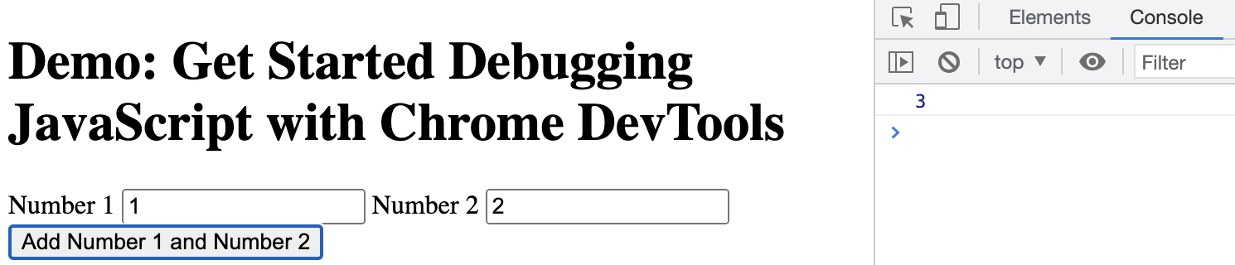
Exercise 3
Open ex3.html in Chrome.
Enter two numbers and check what is printed in the console.
There are two problems. (1) You are allowed to enter non-numbers; (2) The result is not exactly the sum.
Fix the first problem by changing the HTML part only; then fix the second problem with Javascript.

Slide 62
Web Services

Slide 63
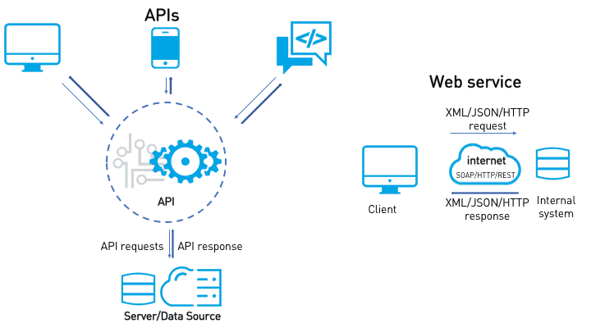
Web Services
Web API
API offers well-packed reusable functionalities (e.g. calendar.py is a standard Python library).
Web API offers API which are on the Web (e.g. Google Maps offer an API to load maps).
Web API allows us to build sophisticated Web app based on existing web services.

Slide 64
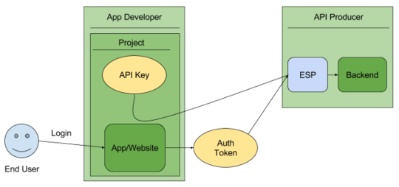
API Key
Why?
Without access control, Web API might be misused.
API key provides identification (who is calling the Web API) and authentication (i.e., only those with the certain keys are allowed to use certain API).
API key should be kept secret.
How?

Slide 65
Example
Weather API
https://openweathermap.org/api
Current weather data
Hourly forecast 4 days
Historical weather data
...
Example API Call
https://api.openweathermap.org/data/2.5/weather?q={city name}&appid={API key}
Documentation: https://openweathermap.org/api/current?collection=current_forecast

Slide 66
Example
Weather API
api.openweathermap.org/data/2.5/weather?q=London,uk&APPID=yourapikey
Try yourself
Sign up (for a free account) at https://openweathermap.org/price
A demo here without leaking my API key :-).

Slide 67
Example
Google Map API
https://cloud.google.com/maps-platform/
API: Maps, Routes, Places, Gaming Solution and more:
https://developers.google.com/maps/documentation/javascript
[Follow the guide given in the above documentation to get the API key and get started]
Example
ex4.html

Slide 68

(optional) Set Up Google Maps Platform Account
Create an account
Setup Billing (unfortunately this requires a credit card)
To be continued...

Slide 69
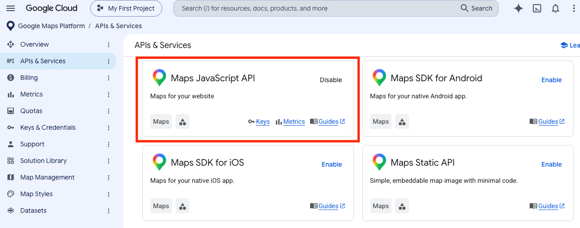
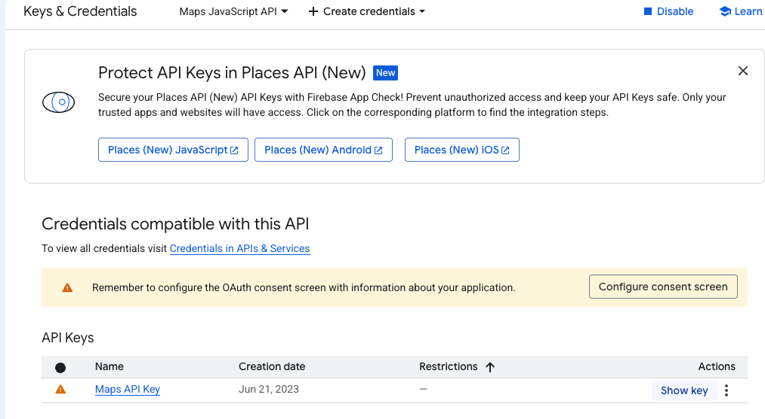
(optional) Get Google Maps API Key
Get a Google Maps API Key
Once setup, you will be in Google Cloud Console.
Find “APIs & Services” in the left panel and search for “Maps JavaScript API”
“Enable” it
Then click on “Keys”
You will get an API key

Slide 70
(optional) Exercise 4
Follow the steps on the previous slides to enable Google Maps API.
Open ex4.html and make sure you see a map
Find the API key in ex4.html and replace it with your API key
Try your best to understand the code
Modify the code to place a marker at SCIS (lat: 1.297538, lng: 103.849558)
Hint: refer to https://developers.google.com/maps/documentation/javascript/adding-a-google-map#javascript

Slide 71
Take Away Messages
HTML for content; CSS for style; Javascript for dynamic effects
HTML is a tree of various kinds of tags/elements
Web API are online libraries
Kindly take note of the course components and be mentally prepared.

